Slide 1
PPE Pro-Track App Presentation
Streamlining Safety and Efficiency

Slide 2




Company - Parktown Manufacturers

Slide 3
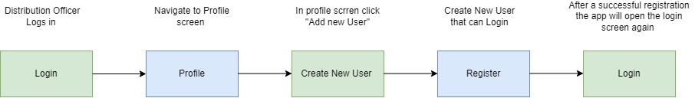
Authentication

Slide 4
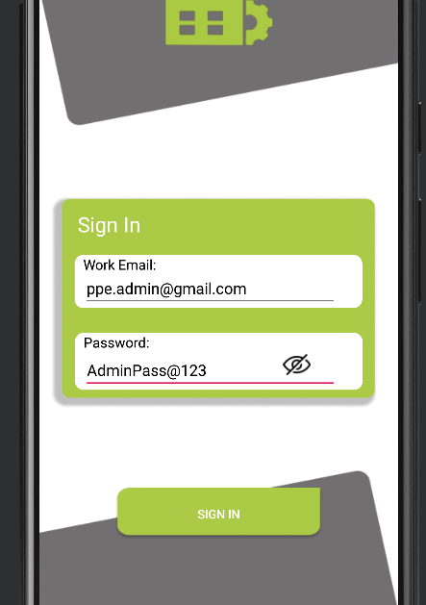
Login

Slide 5
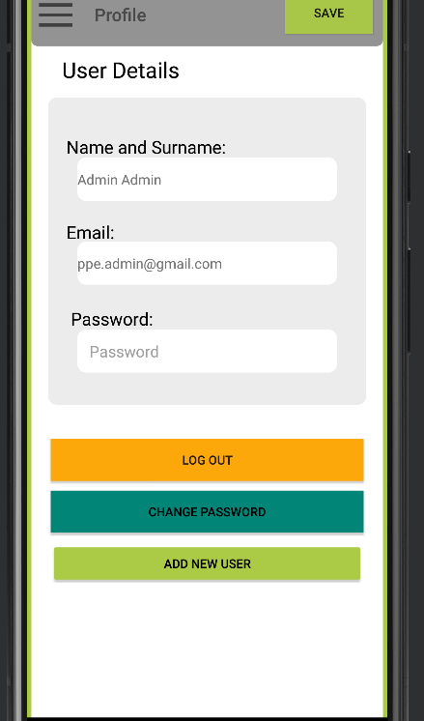
Profile
Adding a new user

Slide 6
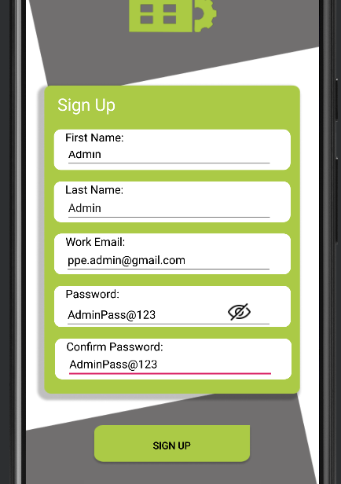
Register

Slide 7
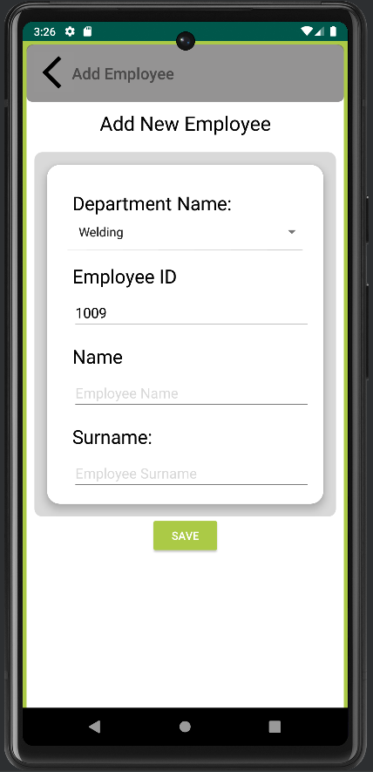
Adding A new employee

Slide 8
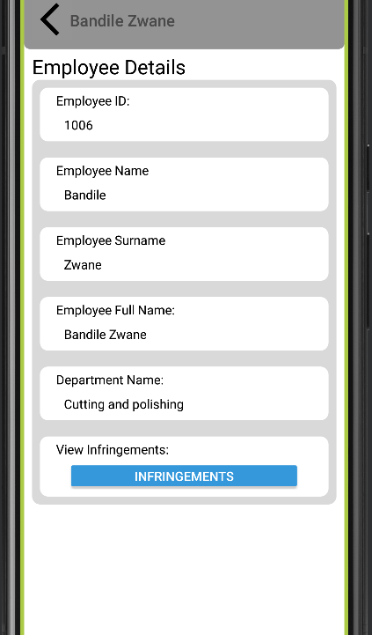
Employee details

Slide 9
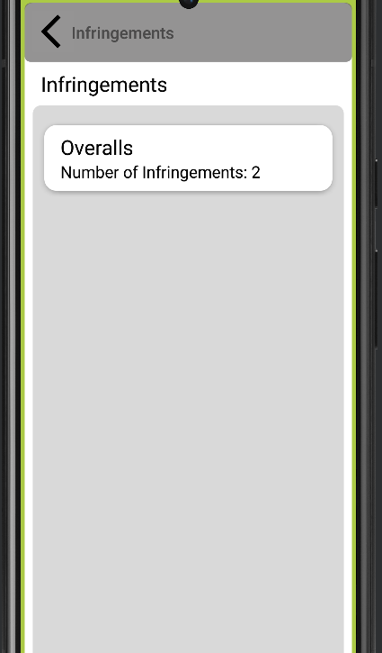
Infringements
Items not returned

Slide 10
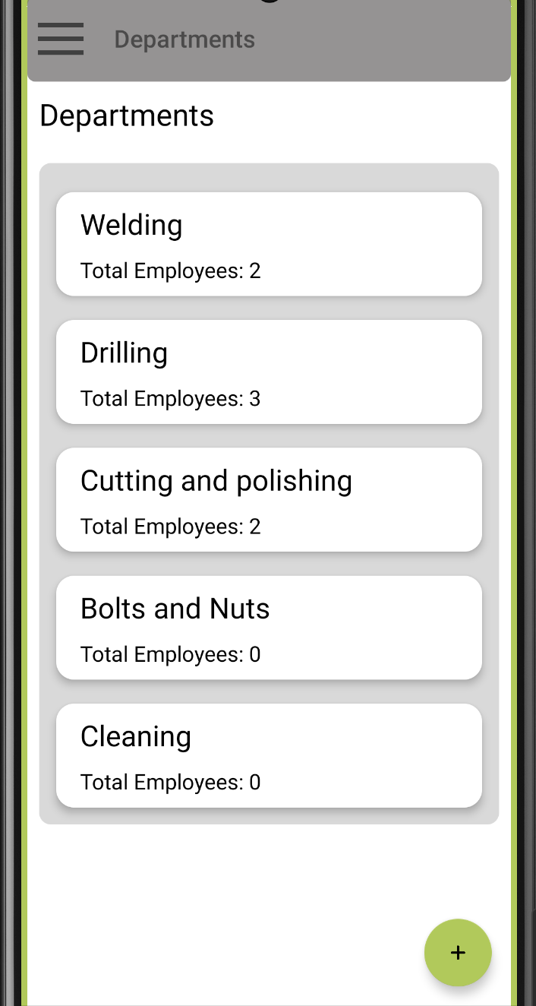
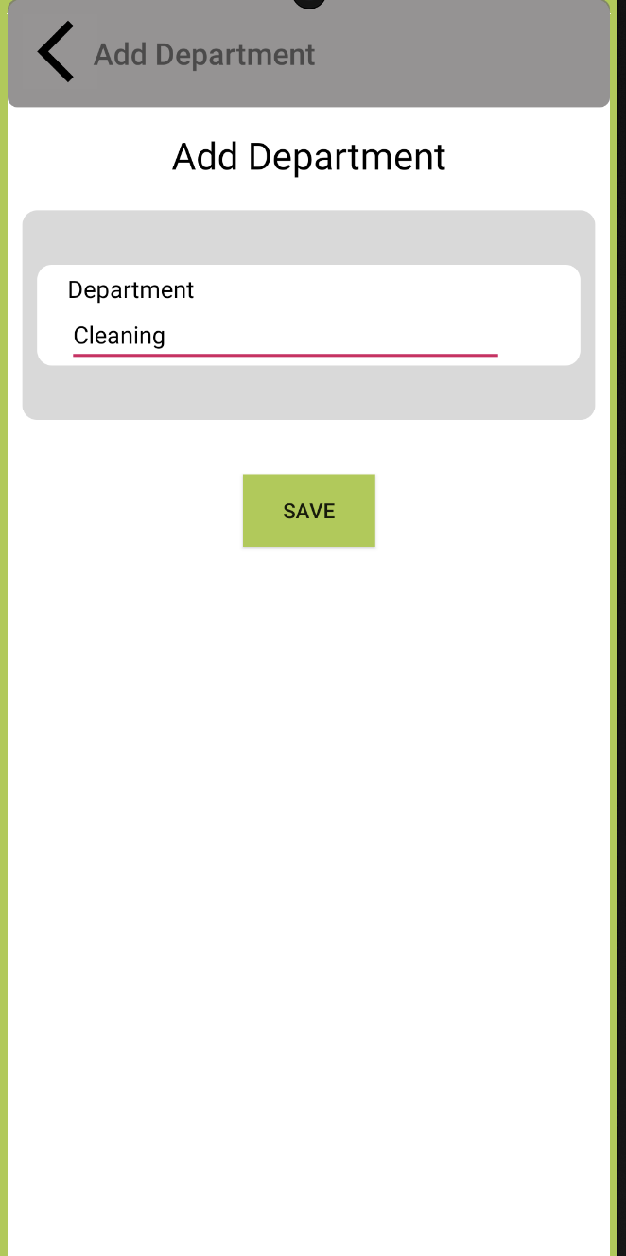
Departments

Slide 11
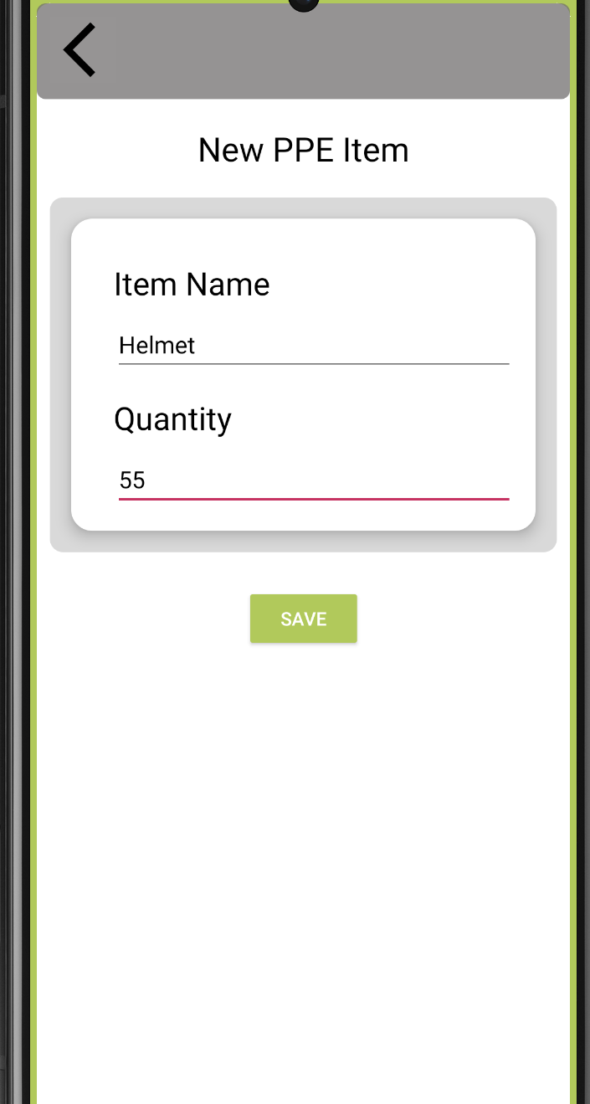
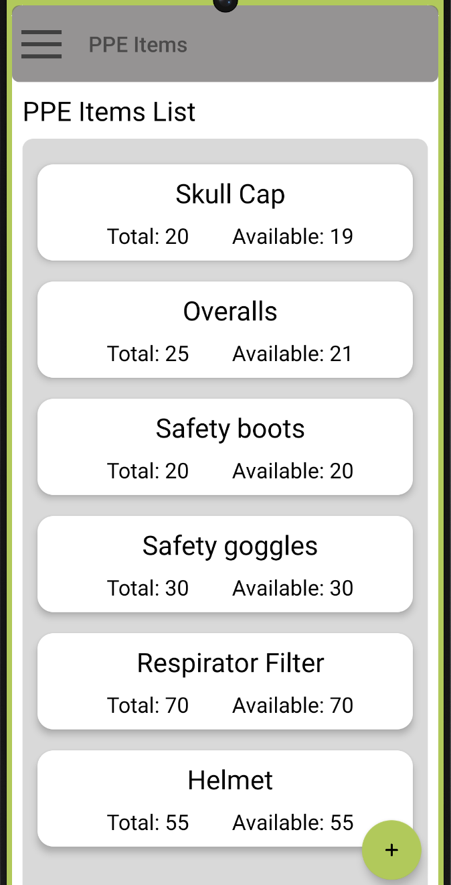
PPE Items

Slide 12
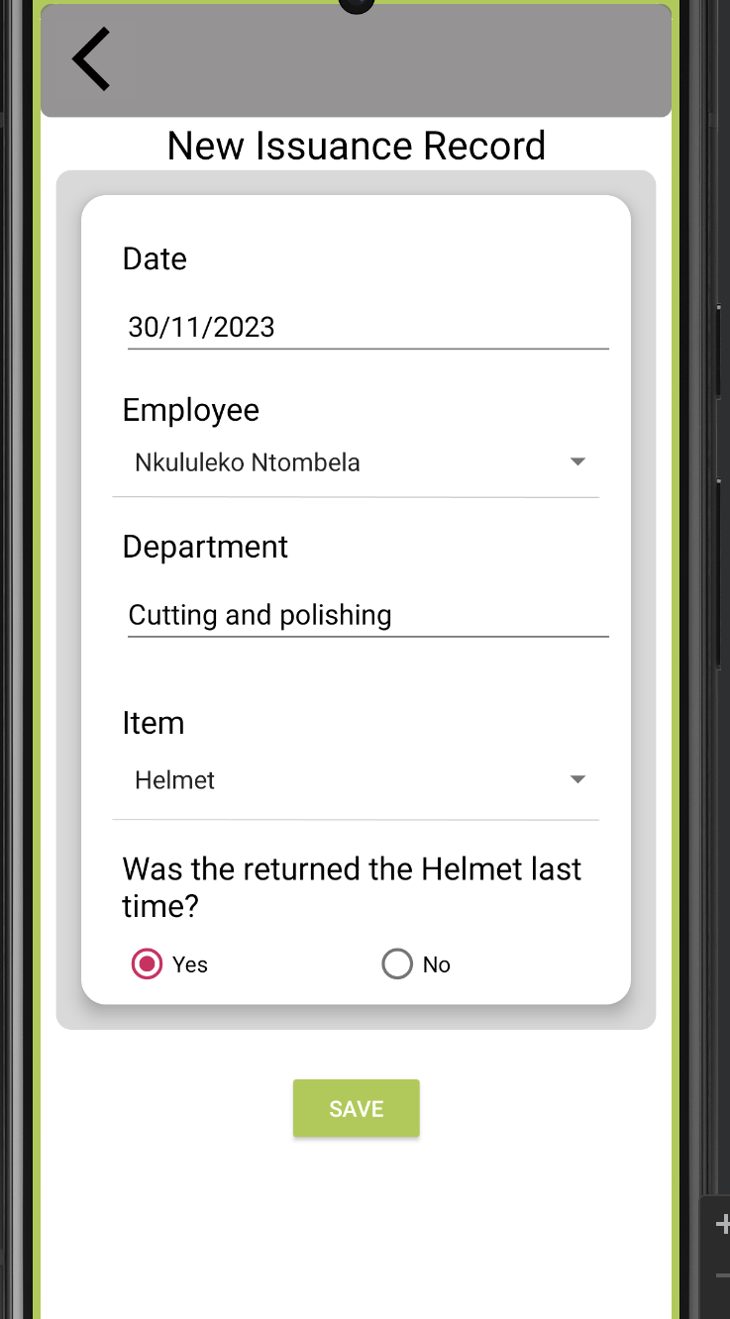
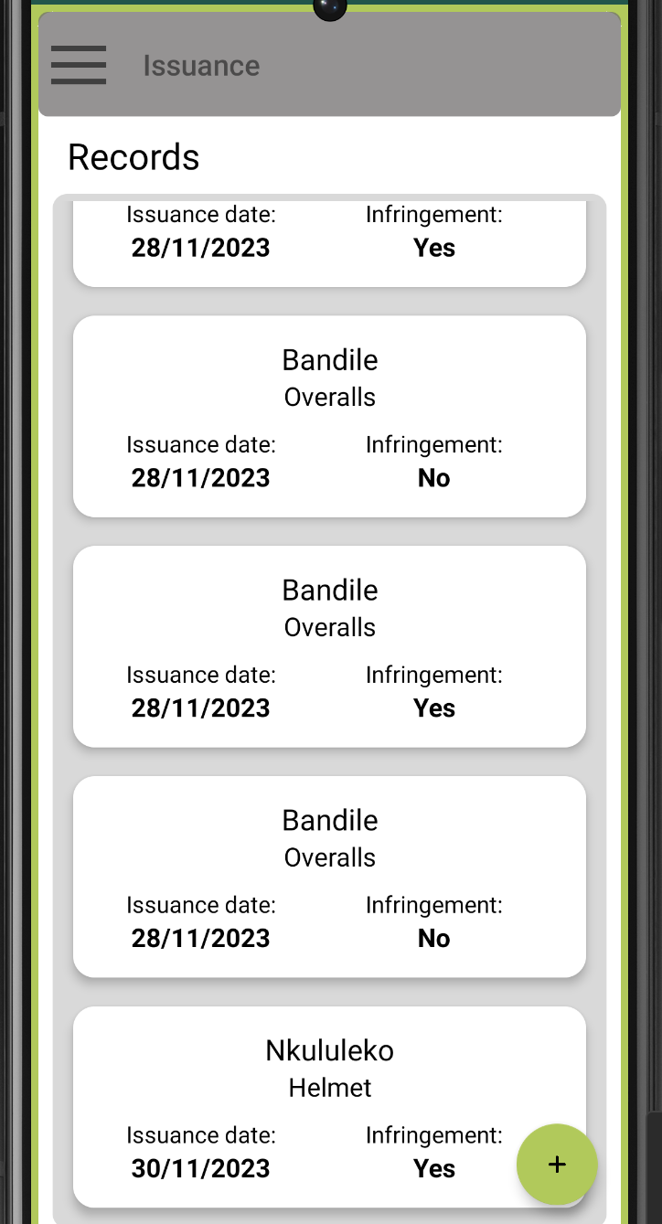
Issuance Functionality

Slide 13

Q&A Section

Slide 14
Thank You

